Slide 1
KOSTA SW300
Capstone PT
2020 Seungup Noh

Slide 2

About
Me
Seungup Noh
네비웍스 BITA 에서 근무
010-5052-8805
삼일공업고등학교 졸업
한국산업기술대학교에서 ICT융합공학 전공
su.noh@naviworks.com
경기도 화성시 거주
Python를 주력언어로 사용
Java, Swift, C/C++ 배우는 중

Slide 3
Index.
¡. 교육 소득
¡¡. Capstone Project
¡¡¡. 앞으로의 계획

Slide 5
Certification
    Study
    Test
    Score

Slide 6
SW300
수료증
Introduction
To
SQL
SW
Engineering
Essentials
Object
Oriented
Design
SW
Architecture
Introduction
To
C++
OS
Power User
Building Cloud Service
With the Java Spring
Framework
HTML5
CSS
JavaScript
Introduction

Slide 7
New Technique
Git
SQL
Spring
HTML
CSS
JavaScript
OS
.

Slide 9
Knowledge
Experiences

Slide 10
Developer
+
=
Code

Slide 11
무형(無形)의 재산, 코드.
    보존하기 위해서 해야할 것은, “ ”.
Save

Slide 12
Save
File
    Multi-Task
    Sharing
    Public | Private

Slide 13
Version
Version
Version
Version
Local_1
Local_1 HDD

Slide 14
Version
Version
Version
Version
Git SVN
Local_1
Local_2

Slide 15
Index.
¡. 교육 소득
¡¡. Capstone Project
¡¡¡. 앞으로의 계획

Slide 16
Capstone Project
2
Web Full-Stack Web Application- Personal

Slide 17
Threads
Comment
title: String
1
comment: String
description: String
*
createTime: Long
createTime: Long
createUserId: Long
createUserId: Long
id: Long
id: Long
Class Diagram
*
*
User
1
1
id: Long
userId: Long
userNickname: String
userPassword: String

Slide 18
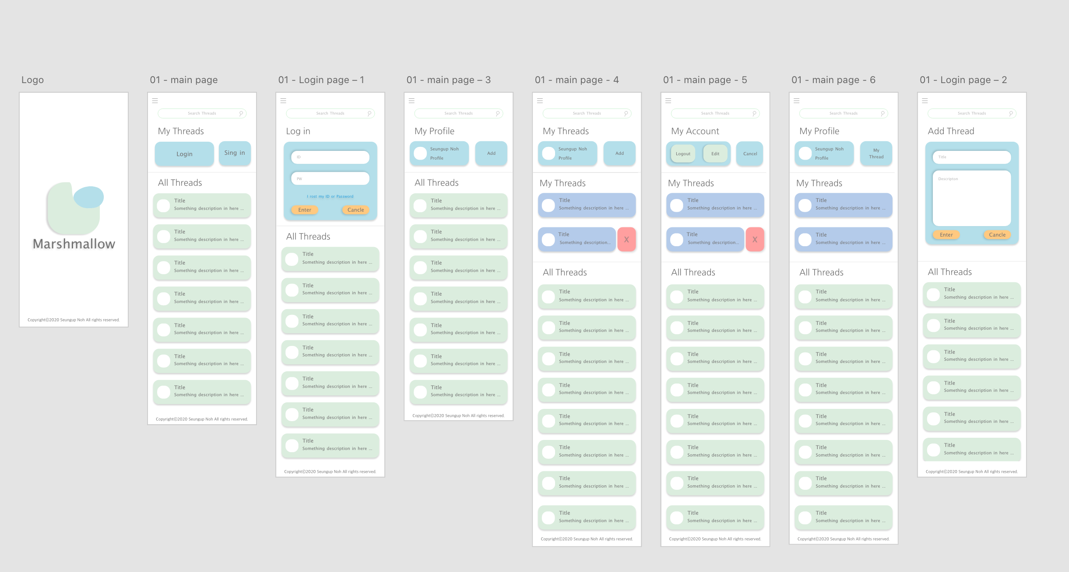
UI Wireframe
Adobe XD

Slide 19
Vue.js

Slide 20
Non-refresh Website
With Vue.js

Slide 21
M V V M
Responsive Web UI

Slide 22







Component
App.vue
search.vue
search
article.vue
ad.vue
<template>
<div>
<v-card
max-width="400"
class="mx-auto"
>
<h1 class="ed-title">All Threads</h1>
<transition>
<div v-if="$store.state.items[0]._embedded.threads.length > 0">
<v-container>
<v-row dense>
<v-col
v-for="(item, i) in $store.state.items[0]._embedded.threads"
:key="i"
cols="12"
>
<v-card
color="#DBEDDE"
dark
rounded
>
<div class="d-flex flex-no-wrap justify-space-between">
<div>
<transition>
<v-card-title
v-if="item.title.length > 15"
class="headline"
v-text="item.title.substring(0, 15) + '...'"
style="color: #707070"
></v-card-title>
<v-card-title
v-if="item.title.length < 15"
class="headline"
v-text="item.title"
style="color: #707070"
></v-card-title>
</transition>
<div >
</div>
<transition>
<v-card-subtitle v-if="item.description.length > 25" v-text="item.description.substring(0, 25) + '...'" style="color: #707070"></v-card-subtitle>
<v-card-subtitle v-if="item.description.length < 25" v-text="item.description" style="color: #707070"></v-card-subtitle>
</transition>
</div>
<v-card-actions>
<v-btn text color="#FFC980">Visit Now</v-btn>
</v-card-actions>
</div>
</v-card>
</v-col>
</v-row>
</v-container>
</div>
<div v-else>
<v-container>
<v-row dense>
<h1 style="color: #707070;">Sorry..</h1>
<h2 style="color: #707070"> Can't find any thread &#128549; </h2>
</v-row>
</v-container>
</div>
</transition>
</v-card>
</div>
</template>
<script>
export default {
name: "AllThreads"
}
</script>
<style scoped>
.ed-title{
color: #707070;
margin-left: 5%;
}
</style>
<template>
<div id="app">
<h1 class="ed-title">Add Thread</h1>
<v-card
width="324"
height="384"
color="#b4dfea"
class="mx-auto mt-5 rounded-xl"
>
<v-card-text>
<v-form>
<!-- Title -->
<v-text-field solo rounded dense placeholder="Title" v-model="title"/>
<!-- Description -->
<v-textarea
solo
name="input-7-4"
placeholder="Description"
rounded
rows="7"
v-model="description"
></v-textarea>
</v-form>
<v-card-actions>
<v-btn color="#ffc980" width="100" class="rounded-card login-btn-1" rounded
v-on:click="$store.commit('setDocState', 'logined')">Cancle</v-btn>
<v-spacer></v-spacer>
<v-btn color="#ffc980" width="100" class="rounded-card login-btn-2" rounded
v-on:click="
$store.commit('setTitle', title);
$store.commit('setDescription', description);
$store.commit('setDocState', 'logined');
fetchData();
">Post</v-btn>
</v-card-actions>
</v-card-text>
</v-card>
<div />
</div>
</template>
<script>
export default {
name: "AddThread",
data() {
return{
title: '',
description: ''
}
},
methods: {
fetchData: function() {
this.$http.post(
this.$store.state.baseUrl + 'threads/',
{
title : this.$store.state.title,
description : this.$store.state.description
}
)
.catch(function(error) {
console.log(error);
}).then(this.$store.commit(
'addThread', {
title: this.$store.state.title,
description: this.$store.state.description
}
)
);
}
}
}
</script>
<style scoped>
.ed-title{
color: #707070;
margin-left: 5%;
}
</style>
<template>
<div>
<v-btn icon v-on:click="$store.commit('chageSearchState')">
<v-icon>mdi-magnify</v-icon>
</v-btn>
<v-btn icon v-on:click="getData">
<v-icon>mdi-refresh</v-icon>
</v-btn>
<v-btn icon v-on:click="$store.commit('changeDiv')">
<v-icon>mdi-magnify</v-icon>
</v-btn>
</div>
</template>
<script>
export default {
name: "Bar",
methods: {
getData: function () {
this.$http.get(
this.$store.state.baseUrl + 'threads/'
).then( (response) => {
console.log("data =", response.data);
this.$store.commit('setThreads', response.data._embedded.threads);
}).catch(function (error) {
console.log(error);
})
},
}
}
</script>
<style scoped>
</style>
Ad
Article

Slide 23
Frontend Project Dir
/root
/assets
; Logo, Pictures, etc.
/components
; Web Pages components. Func
/plugins
; Plugins
/store
; Define Global Func, Var
App.vue
; Define HTML
main.js
; Define Global Library

Slide 24
/root
/src
/assets
/css
/js
/components
Building…
index.html
/plugins
/store
App.vue
main.js

Slide 25

Serverless
AWS S3
/src
Function();
Function();
/css
Function();
Function();
Function();
Function();
/js
Function();
Function();
Function();
Function();
index.html
Function();

Slide 26
Backend

Slide 27











Capstone 2. Full-Stack Web Application
Nickname
Title
User
Thread
Id
User.Nickname
Back
-End
Password
Description
Comment
Create Time
Comment
User.id
Create Time

Slide 28
<<ORM Persistable>>
<<ORM Persistable>>
Threads
Comment
title: String
1
Comment
comment: String
description: String
Threads
*
createTime: Long
createTime: Long
createUserId: Long
createUserId: Long
id: Long
id: Long
Threads
*
*
Comment
User
User
<<ORM Persistable>>
User
1
1
id: Long
userId: Long
userNickname: String
userPassword: String

Slide 29



Capstone 2. Full-Stack Web Application
AWS EC2
Title
Thread
Back
-End
Description
Create Time
©
©
©
Threads.java
User.java
Comment.java

Slide 30
Frontend
Backend
Database
Client
Browser
S3
EC2
RDS
Enter the Web-Site
HTML Doc Request
index.html
Load Web-Site
New Page Request
Component Data Request
GET
SQL Commands
SQL Data
POST
JSON DATA
Non-Refresh Page update

Slide 31
To-Do
게시판

Slide 32
Frontend
過猶不及; Too much는 좋지 않다!

Slide 33
http://nsu-sw300-kosta.s3-website.ap-northeast-2.amazonaws.com/

Slide 34
앞으로의 계획
Capstone 프로젝트 구체화
언어에 대한 공부 지속
새로운 웹 어플리케이션 추가 개발

